Slide 2
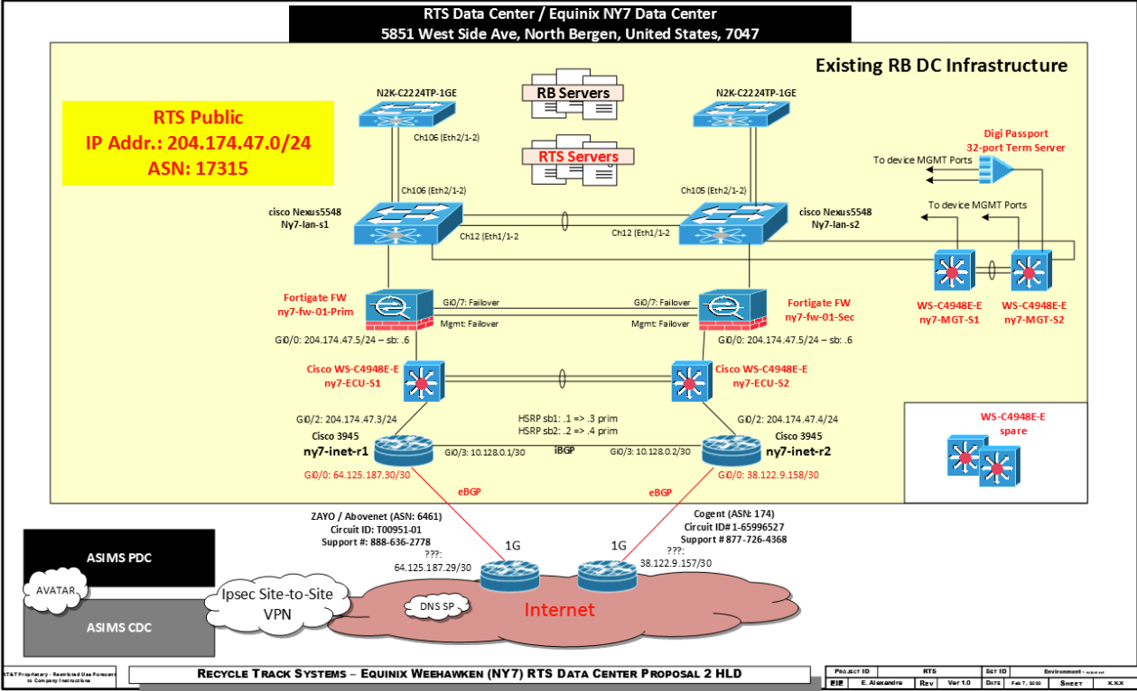

Slide 3
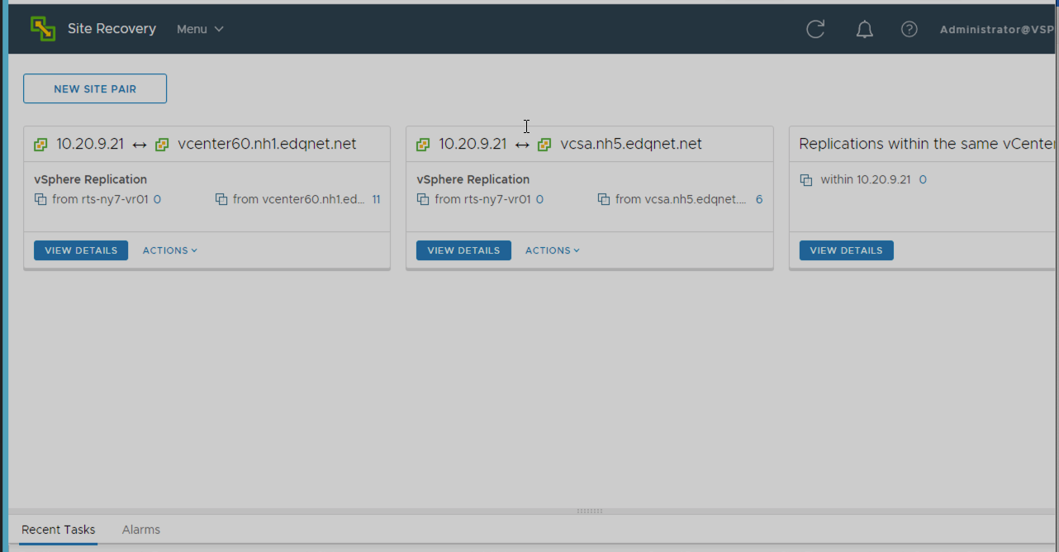
Site Pairing: Equinix, Dunbarton, and Manchester

Slide 4
SRM 8.2 Architecture
A paired configuration
Minimum Requirement: ESXi Host + vCenter Server + VMs
Choice of Replication
vSphere Replication ESXi Host + vCenter + SRM 8.2 + VR 8.2
VxRail needs vCenter Appliance + License
Dunbarton Datacenter
Equinix Availability Zone
vCenter Server
Site Recovery Manager 8.2
vCenter Server
Site Recovery Manager 8.2
VM
VM
vSphere Replication
vSphere Replication
vSphere Replication
VM
VM
vSphere ESXi 6.7
vSphere ESXi 6.7

Slide 5
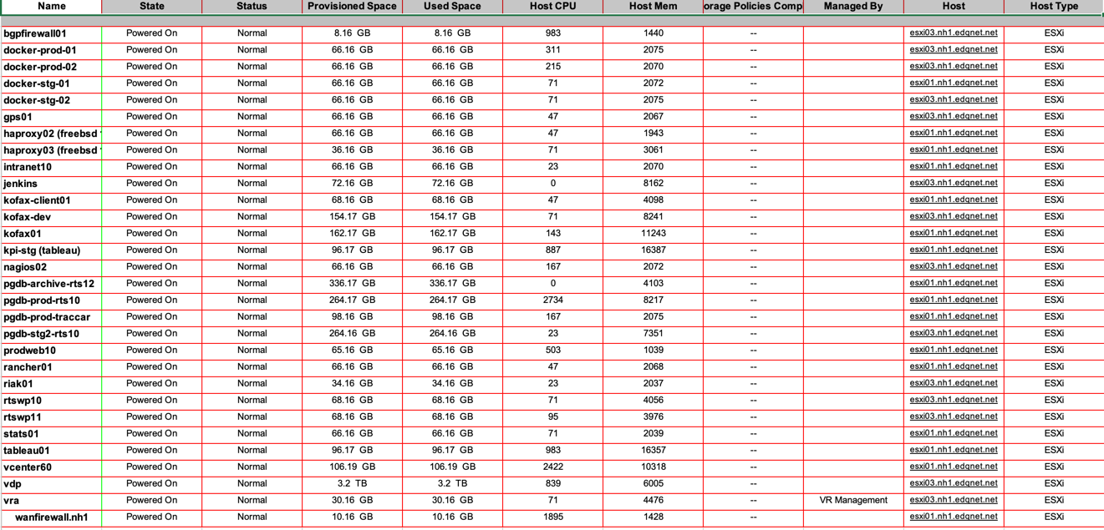
Dunbarton VM Configuration

Slide 6
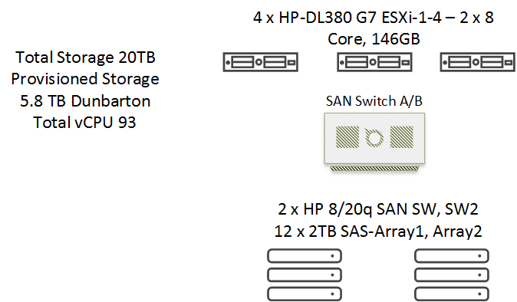
Dunbarton Compute and Storage Equipment

Slide 7
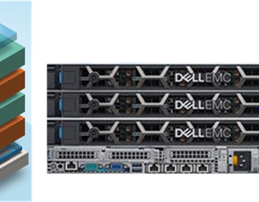
VxRail E560F, 10x25, Flash E5605, 2 Processors, 16C, 256 RAM each with 1.6TB SSD Cache x2, and 1.9TB SSD Capacity

Slide 8
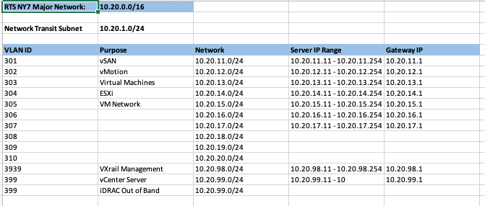
VLAN IDs

Slide 9
Dedicated Resource to Equinix AZ
Active Passive Failover
Production Site Dunbarton and keep the recovery site Equinix until ready to failover

Slide 10
Prerequisites to install VMware Site Recovery Manager
Synchronize the clock settings of the systems on which Platform Services Controller, vCenter Server, and Site Recovery Manager Server run.
To use Site Recovery Manager with vSphere Replication, deploy the appropriate version of vSphere Replication on both of the protected and recovery sites before you install Site Recovery Manager Server.

Slide 11
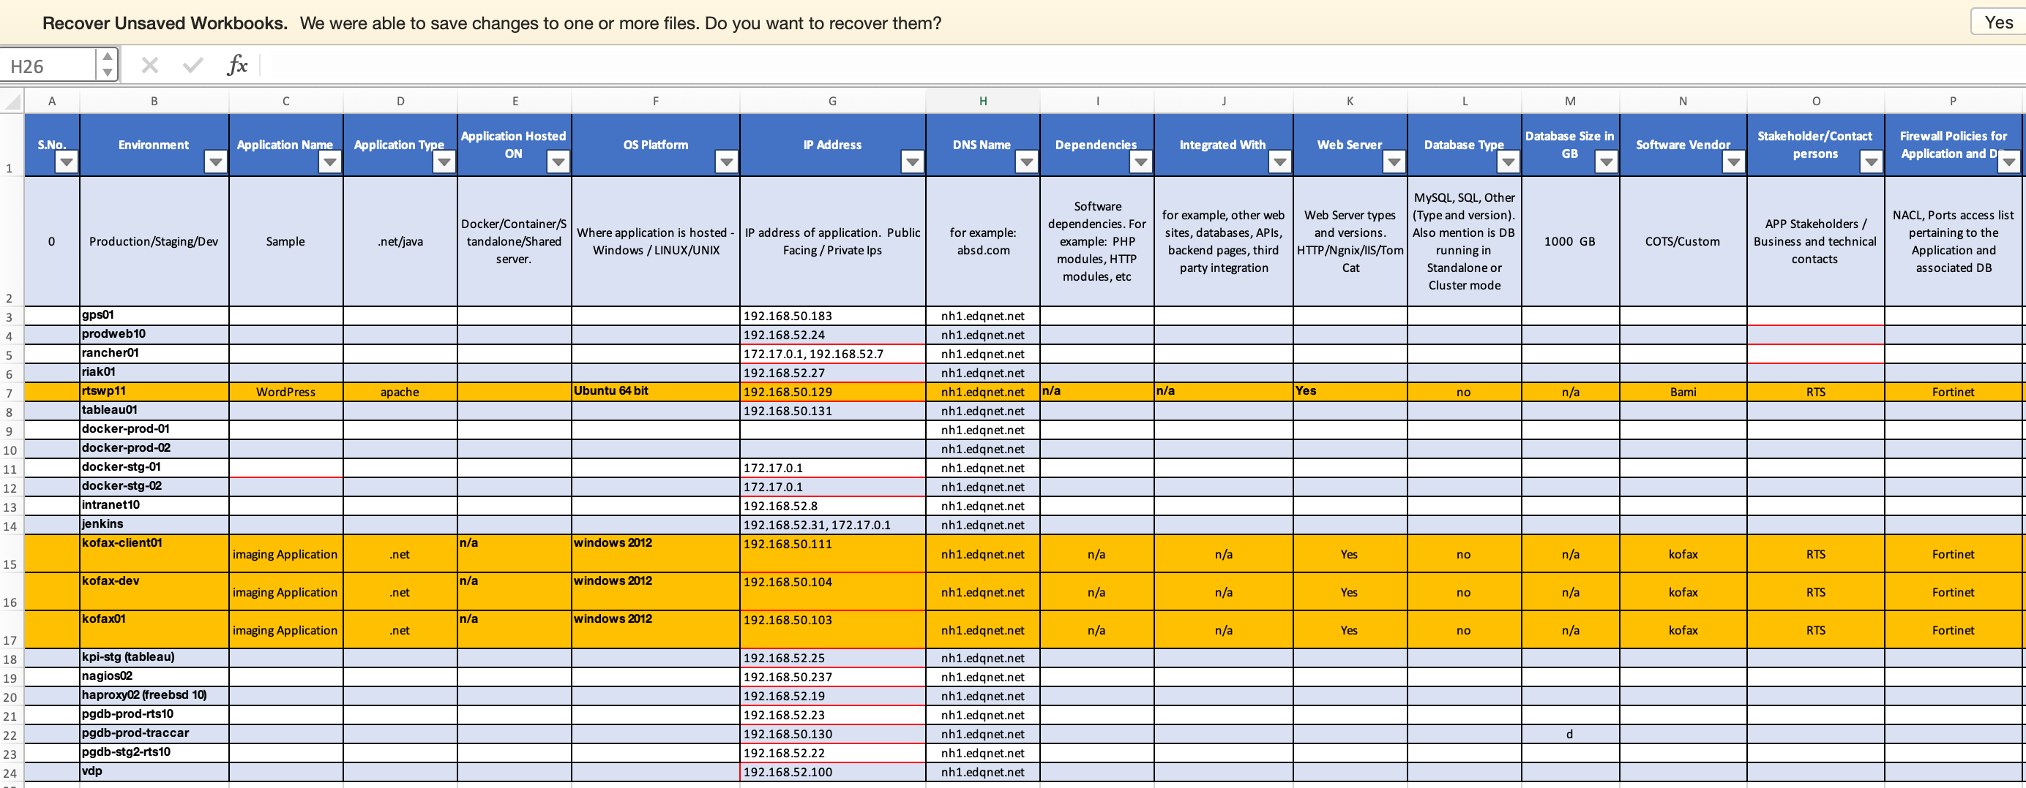

Slide 12
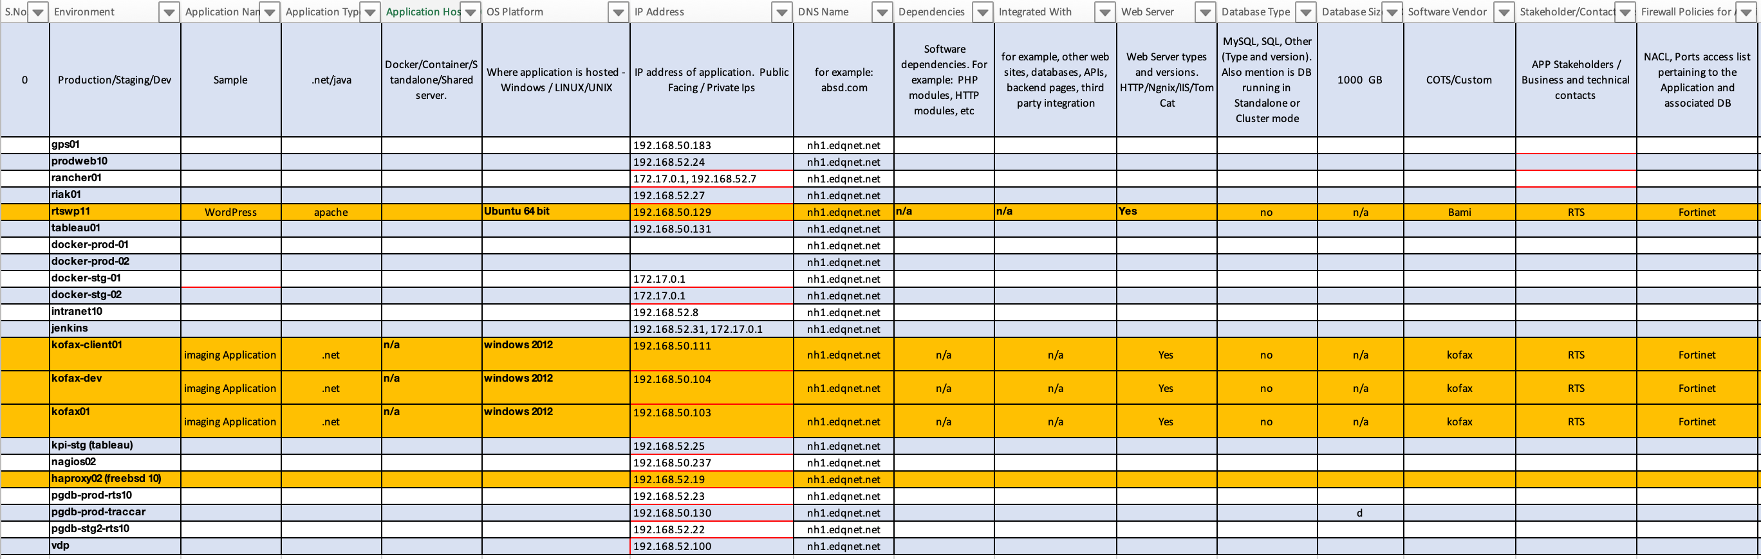
VM Testing

Slide 13
Jim/mw Baseline Replication Test and test again rtswp11 VM
Timeline Estimated Assumption 2 Days to Test rtswp11 VM Performance, portability, Network connectivity and communication for External Users & Users
Configure Replication In Dunbarton Datacenter and Equinix Availability zone vSphere Replication Appliance
Select a target site from vCenter server in Dunbarton Datacenter from the configure see target site select Equinix Availability Zone IP Address.
Replication a rtswp11 VM from Dunbarton datacenter to Equinix Availability Zone
VM in Dunbarton DC to be protected
Jim Rascoe/MW will Power Off Dunbarton Protected rtswp11 VM
Jim Rascoe/MW Power On, boot and startup application services for business continue services
Satya/Rajnish/MW/Jim Verify External Users & Users experiences – can they access and do work as normal
If verification success continue to monitor the rtswp11 VM
Verify External Firewall and Haproxy2 routing rules port 443
Verify rtswp11 Certificate
External Users & Users should be able to login and do business continuous services
If External Users are unable to access rtswp11 VM
Jim/MW Power Off rtswp11 VM in Equinix NY7
Jim Power on rtswp11 in Dunbarton for business continuous services

Slide 14
Jim/mw Baseline Replication Test and test again Kofax VMs
Select a target site from vCenter server in Dunbarton Datacenter from the configure see target site select Equinix Availability Zone IP Address.
Replication a Kofax-client, Kofax, Kofax-dev VMs from Dunbarton datacenter to Equinix Availability Zone
VM in Dunbarton DC to be protected
Jim Rascoe/MW will Power Off Dunbarton Protected a Kofax-client, Kofax, Kofax-dev VMs Jim Rascoe/MW Power On, boot and startup application services for business continue services
Satya/Rajnish/MW/Jim Verify External Users & Users experiences – can they access and do work as normal
If verification success continue to monitor the a Kofax-client, Kofax, Kofax-dev VMs
Verify External Firewall and Haproxy2 routing rules port 443
Verify rtswp11 Certificate
External Users & Users should be able to login and do business continuous services
If External Users are unable to access a Kofax-client, Kofax, Kofax-dev VMs
Jim/MW Power Off rtswp11 VM in Equinix NY7
Jim Power on rtswp11 in Dunbarton for business continuous services
Timeline Estimated Assumption with JIM 2 Days to Test VM dependency

Slide 15
Jim/mw Test and test again VM Dependency
Application discovery
docker-prod-01
docker-prod-02 | 172.17.0.1
docker-stg-01 | 172.17.0.1
docker-stg-02
gps01 | 192.168.50.183,
haproxy02 (freebsd 10) | 192.168.52.19
intranet10 | 192.168.52.8
jenkins | 192.168.52.31, 172.17.0.1
kpi-stg (tableau) | 192.168.52.25
nagios02 | 192.168.50.237
pgdb-archive-rts12
pgdb-prod-rts10 | 192.168.52.23
pgdb-prod-traccar | 192.168.50.130
pgdb-stg2-rts10 | 192.168.52.22
prodweb10 | 192.168.52.24
rancher01 | 172.17.0.1, 192.168.52.7
riak01 | 192.168.52.27
tableau01 | 192.168.50.131
vdp | 192.168.52.100
Notes:
Application discovery
In addition to discovering machines, Azure Migrate: Server Assessment can discover apps, role, and features running on machines. Discovering your app inventory allows you to identify and plan a migration path tailored for your on-premises workloads.
Table 2 Support Details Discovery Discovery is agentless, using machine guest credentials, and remotely accessing machines using WMI and SSH calls. Supported machines On-premises VMware VMs. Machine operating system All Windows and Linux versions. vCenter credentials A vCenter Server account with read-only access, and privileges enabled for Virtual Machines > Guest Operations. VM credentials Currently supports the use of one credential for all Windows servers, and one credential for all Linux servers. You create a guest user account for Windows VMs, and a regular/normal user account (non-sudo access) for all Linux VMs. VMware tools VMware tools must be installed and running on VMs you want to discover. If your VMware tools version is between 9.10 - 10.2.0, please ensure you upgrade it to beyond 10.2.0. Powershell VMs must have Powershell of version 2.0 or above Port access On ESXi hosts running VMs you want to discover, the Azure Migrate appliance must be able to connect to TCP port 443. Limits For app-discovery you can discover up to 10000 per appliance.

Slide 16
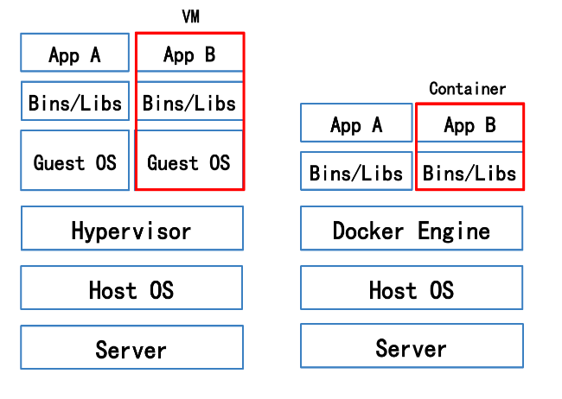
VM and Container Architecture
Timeline Estimated Assumption with JIM 2 Days to Test VM dependency
Jim Rascoe/MW will Power Off Dunbarton Protected VM or Docker Container
Jim Rascoe/MW Power On, boot and startup application services for business continue services
Satya/Rajnish/MW/Jim Verify External Users & Users experiences – can they access and do work as normal
If verification success continue to monitor the VM or Docker Container
Verify External Firewall and Haproxy2 routing rules port 443
Verify rtswp11 Certificate
External Users & Users should be able to login and do business continuous services
If External Users are unable to access VM or Docker Container
Jim/MW Power Off VM or Docker Container in Equinix NY7
Jim Power on VM or Docker Container in Dunbarton for business continuous services

